Slide 1
Influence maximization in complex networks through optimal percolation
Jeroen Van Der Donckt &
Mathias Deloof

Slide 2
Overview
The optimal influence problem
Solutions
Collective influence
Collective influence algorithm

Slide 3
The optimal influence problem
= finding the optimal set of influencers
Ex. spread information to the whole network, optimally immunize a network against epidemics
Notes:
Optimal = mininimal

Slide 4
Solutions – Heuristic methods
Don't optimize a global function of influence => No guarantee of their performance
Ex. HD, HDA, google pagerank, ...

Slide 5
Solutions – Optimal percolation
Measure of influence: size largest (giant) component
Percolation theory: if we choose random nodes to be deleted, the network undergoes a structural collapse at a certain critical fraction
Find minimum fraction (q_{c}) q_{c} = min{q ∈ [0,1]: G(q) = 0} with q = 1 - (# nodes not removed)/(initial # nodes)
𝜈_{i—>j} order parameter
Notes:
Percolation in random networks
Percolation theory: … critical fraction, the probability of existence of the giant component = 0
Optimal influence problem corresponds to finding minimum q_{c} to fragment the network
𝜈_{i—>j} :probability that i belongs to the giant component and j is absent

Slide 6
Solutions – Optimal percolation
Absence of giant component: 𝜈_{i—>j} = 0 ∀ i->j
Stability: largest eigenvalue 𝜆(n; q)
ℳ_{k->l,i->j} = n_{i} * ℬ_{k->l,i->j}
Max eigenvalue ≤ 1 -> Critical threshold: 𝜆(n*; q_{c}) = 1
Ex. Non optimized solution: choose n_{i} at random and decoupled from the matrix
Notes:
Stability of the solution (𝜈_{i—>j} = 0 ) is controlled by 𝜆 (of M)
ni = 1 if node i is not removed; ni = 0 if node i is removed
Requires 𝜆 <= 1
Minimization of the largest eigenvalue of the modiefied NB matrix for random networks

Slide 7
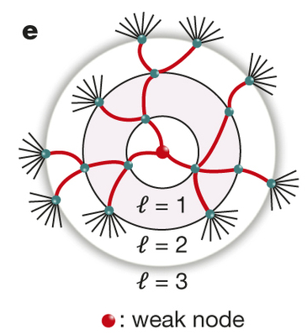
Collective influence
Weak node: low-degree nodes that play a broker role in the network
Notes:
Despite being weekly connected, these nodes can be powerful influencers

Slide 8
Collective influence
Eigenvalue 𝜆(n) determines the growth rate of an arbitrary vector w0
Largest eigenvalue: λ(n) =lim⁡_{l ->∞} [ |w_{l}(n)| /|w₀| ] ^{1/l}
|w_{l}(n)|² = Σ(k_{i} -1) Σ_{j ε 𝜕Ball(i, 2l-1)} ( Π _{k ε 𝒫 2l-1 (i,j)} n_{k} ) (k_{j} - 1) for l ≥ 1
Notes:
By increasing the radius l of the ball we obtain better and better approximations of the optimal exact solution

Slide 9
Collective influence
CI_{l}(i) = (k_{i} - 1) * Σ _{j ε 𝜕Ball(i,l)} (k_{j} - 1)
Concept CI algorithm:
Initialize: all nodes are present: ni = 1 ∀ I
We remove node i* with highest CI_{l}
The degree of each neighbour of i* is decreased by one
Repeat the procedure to find the new CI top node to remove
Stop if giant component = 0
Notes:
Note that Ball(i,l) is the set of nodes inside the ball and thetaBall are the nodes on the frontier of the ball

Slide 10
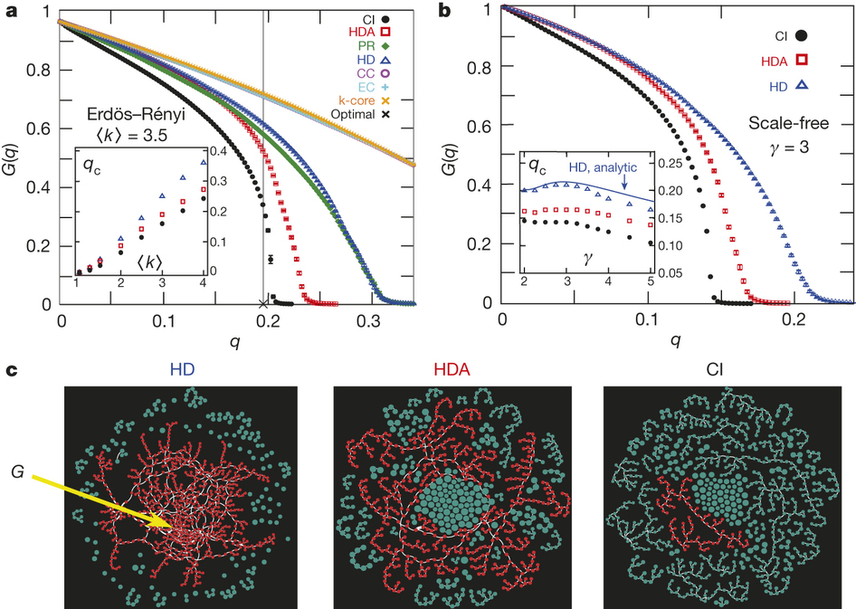
Collective influence

Slide 11
Collective Influence Algorithm
Linear time: O(NlogN)
Max-heap data structure

Slide 12
Collective Influence Algorithm
Step 1 - Computing CI
CI value: CI_{l}(i) = (k_{i} - 1) * Σ _{j ε 𝜕Ball(i,l)} (k_{j} - 1)
Breadth first search
O(N)
Notes:
find the nodes belonging to the frontier ∂ B(i, ℓ) of the ball of radius ℓ centered on i using a simple breadth-first-search up to a distance ℓ from the central node i.

Slide 13
Collective Influence Algorithm
Step 2 - Building the max-heap
Bottom-up fashion
O(N)
Notes:
bottom-up fashion, from the leaves to the root
-> First fill the heap with arbitrary values and then we heapify all the levels starting from the lowest one.
=> Root stores automatically the largest CI value

Slide 14
Collective Influence Algorithm
Step 3 - Removal
Remove node with largest CI value
Decrement degrees of neighbours by one
Replace root
O(logN)
Notes:
Root = node with larges CI value
replacing the old root with the rightmost leaf in the last level of the heap, decreasing the size of the heap by one, and heapifying the heap

Slide 15
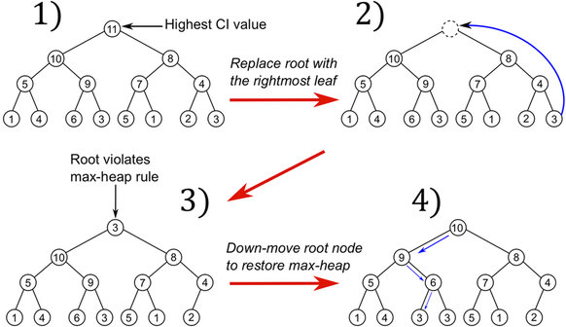
Collective Influence Algorithm
Step 3 - Removal
Notes:
replacing the old root with the rightmost leaf in the last level of the heap, decreasing the size of the heap by one, and heapifying the heap
Heapifying: move node down the tree by swapping it with the largest children until max-heap property is statisfied

Slide 16
Collective Influence Algorithm
Step 4 - Updating CI values
Nodes perturbed by removal: distance 1, 2, …, l, l + 1 -> nodes in ball B(i, l + 1)
Nodes at l + 1: CI value decreases by k -1
Nodes at 1, 2, …, l: recompute CI (step 1)
Restore max-heap structure after each update
O(logN)
Notes:
Only CI value of perturbed nodes must be updated
K = degree of node
-> restore the max heap-structure AFTER EACH CHANGE OF THE CI VALUES
- heapify only the sub-trees rooted on those nodes (because nodes can only be smaller than their old values)
- each node update must be followed by the corresponding heapification, before updating the next node

Slide 17
Collective Influence Algorithm
Step 5 - Stopping the algorithm
λ(l;q) =[ Σ_{i}CI_{l}(i)/(N<k>) ] ^{1/(l + 1)}
Nearly no additional computational cost
Notes:
<k> is the average degree of the network for q=0
When λ(l;q) = we can stop the algorithm
Can be updated on runtime so there is nearly no additional computational cost

Slide 18
Collective Influence Algorithm
Step 6 - Reinsertion
Nodes are reinserted in the network
Join the smallest number of clusters
NOT the smallest cluster!!!

Slide 19
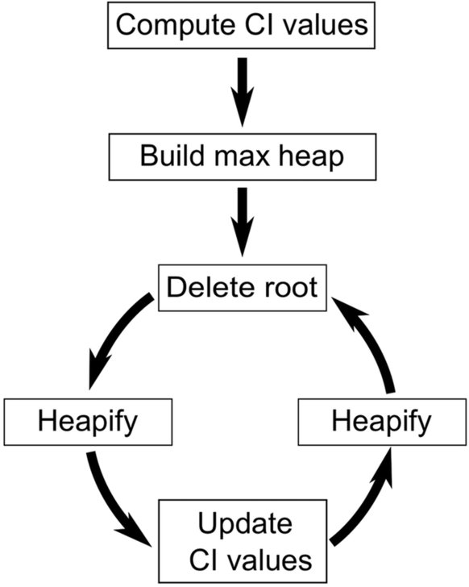
Collective Influence Algorithm
Notes:
First 2 parts only executed once
Loop:
Remove node with heighest CI
Heapifying heap from the new root (rightmost child)
Updating CI values and for each update heapify sub-trees of updated node
Loop ends when giant component is destroyed

